Slide 1
Vaccine Equity Team 2
Sponsor: BU Spark!
Client: Dr. Julia Koehler
Member: Kush Vekeria, Liyu Qu, Jingyi Li, Zhou Ye

Slide 2
Goals and Background
Goals:
To understand the impact of grassroots organizations, like La Colaborativa, in the distribution of Covid-19 vaccinations of various age groups
To discover trends in vaccination rates amongst age groups with a particular focus on pediatric populations.
Background:
Access to quality healthcare and reputable information remains an issue for underserved communities in the State of Massachusetts
Our team’s primary focus was upon vaccinations by age group with emphasis on understanding the impact of efforts on pediatric vaccinations.
We have two data sets (Grouped.csv and Zipcode.csv) .

Slide 3
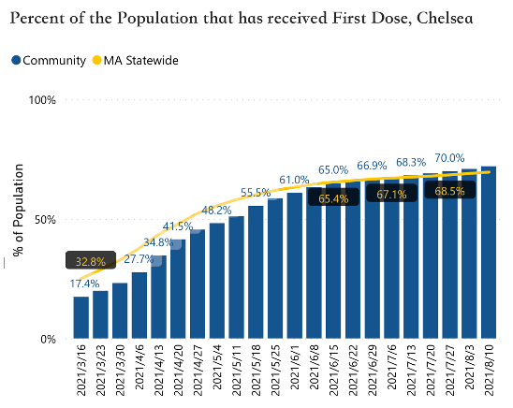
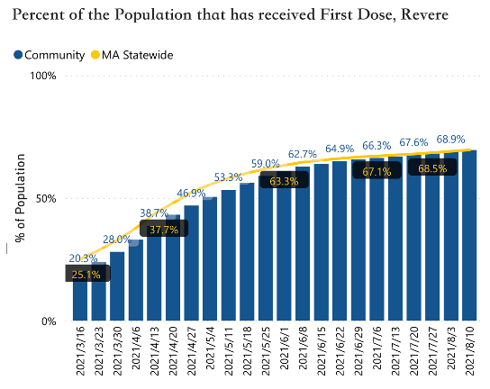
Goals and Background
According to the statistics from website of Massachusetts government. At the beginning of the pandemic, Chelsea really fell behind the average rate of the MA statewide. However, with the help of La Colaborativa, Chelsea surpassed the average rate in only 3 months, while Revere still did not do that in 4 months.

Slide 4
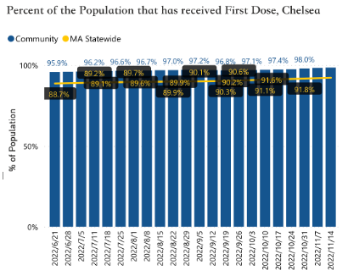
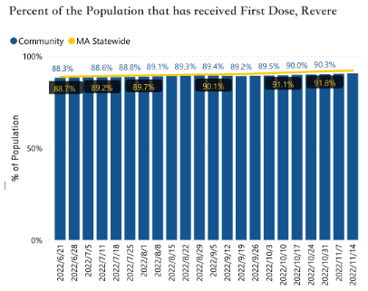
Goals and Background
Rates in Chelsea exceeded the average rates a lot, while Revere still have not achieved the average rates till now.

Slide 5
Data Collection
Grouped Dataset:
Split the whole dataset into 36 small dataset by age (0-19, 20-29, 30-49, 50-64, 65-75, 75+) and city (Chelsea, Revere, Springfield, Everett, Newton, Wellesley).
Used Interpolate method to fill empty data and keep the number of vaccination in an increasing trend
Zipcode Dataset:
Split the dataset by city (Wellesley, Chelsea, Revere, Springfield, Everett, Newton)
Used interpolation to fill empty values and maintain a linear trend.
Applied cumulative summation to each group to understand increasing trends in vaccination over time.
Main Challenges:
In the Grouped dataset, due to too many missing data in 0-19 age range; we could not process the data into a complete time series.
Lots of NaN values results in missing data even after predictive measures (such as interpolation)

Slide 6
Main Analysis:
Regression Model
To understand the importance of certain features in overall vaccination rate
Fully Vaccinated Rate vs. Date
To see and compare the changes of the fully vaccinated rate in different cities
At Least One Dose Rate vs. Date
To see and compare the changes of the At Least One Dose rate in different cities
Hypothesis Tests
To test and find the impact of La Colaborativa
Notes:
Hypothesis test: We use hypothesis t test to test if the increase rate of vaccination in Chelsea is enough to be thought that we can reject null hypothesis and support that La Colaborativa has significant impact on vaccination (p<0.05).

Slide 7
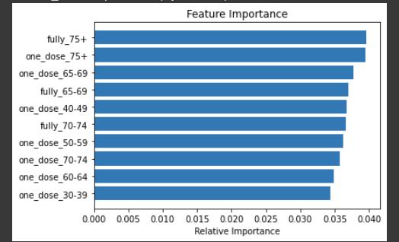
Regression Model – Feature Selection
Vaccinations records that included only one dose of a two-dose vaccination set tended to play a strong role in predicting the overall vaccination trends for each group.
Vaccination records that included both doses of a two-dose regimen tended to be a stronger influence over vaccinations of older individuals (65+ years of age) as compared to one dose for younger populations
Top 10 most significant features

Slide 8
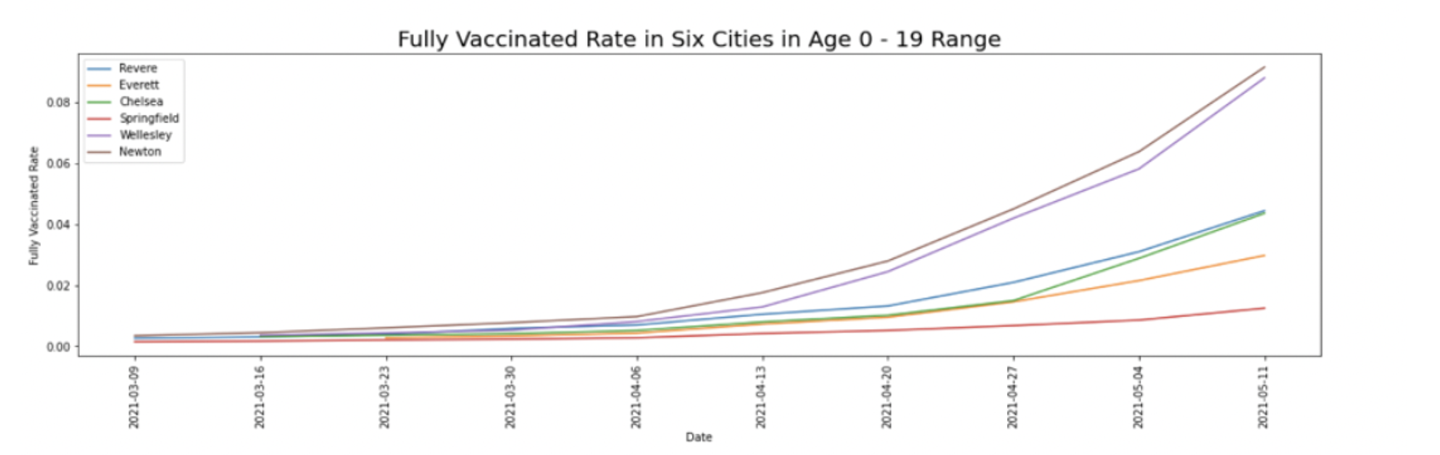
Fully Vaccinated Rate vs. Date
Notes:
We graphed the following fully vaccinated rate graphs for six age ranges (age 0-19, age 20-29, age 30-49, age 50-65, age 60-75, age 75+) and each line in the graphs corresponds to a city. The purpose is to figure out the characteristics and discrepancies of vaccination rate between different cities in each age range.
Because there are too many missing data for people aged 0-19, we cannot process the data to the complete timeline by any method.

Slide 9
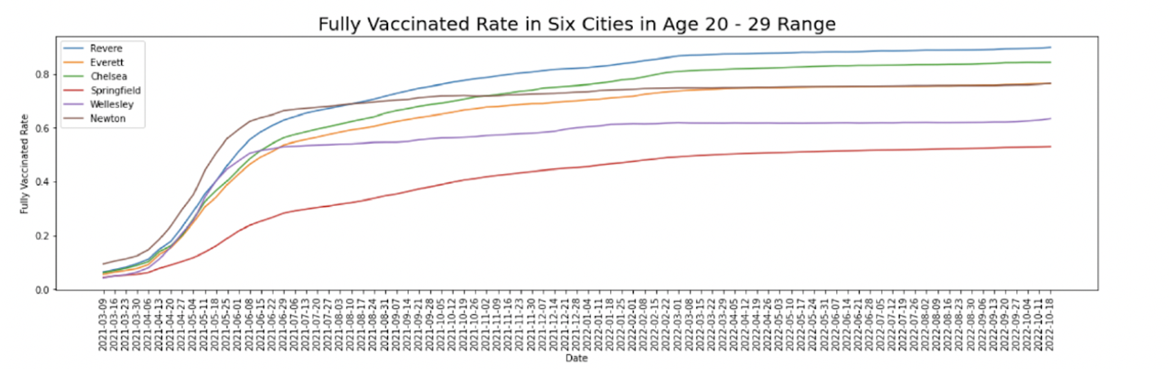
Fully Vaccinated Rate vs. Date
Notes:
By the graphs of fully vaccinated rate in age ranges 20-29, we can find that In the May and June of 2021, a large number of people were vaccinated.
Green line is Chelsea. Chelsea had a relatively high vaccination rate in the age group 20-29.

Slide 10
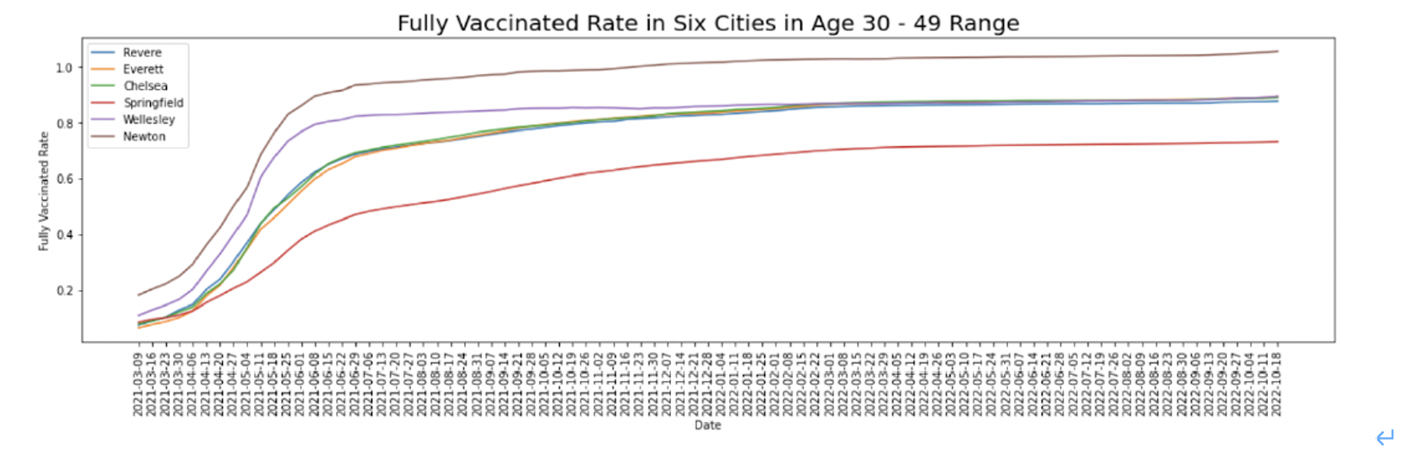
Fully Vaccinated Rate vs. Date
Notes:
For age range 30-49, the increase rate in all cities did not have a significant increase. Chelsea, Everett, Wellesley and Revere had the same fully vaccinated rate which was 80%.

Slide 11
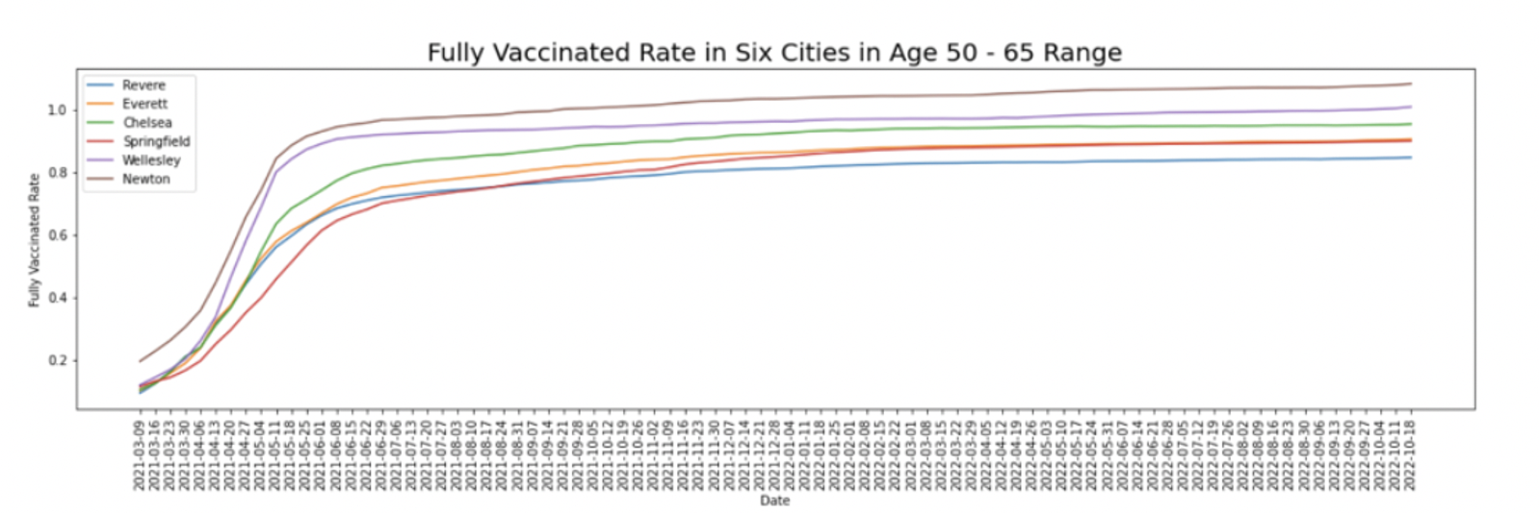
Fully Vaccinated Rate vs. Date
Notes:
People in the 50-65 age group received a large number of vaccinations from April 2021 to May 2021.

Slide 12
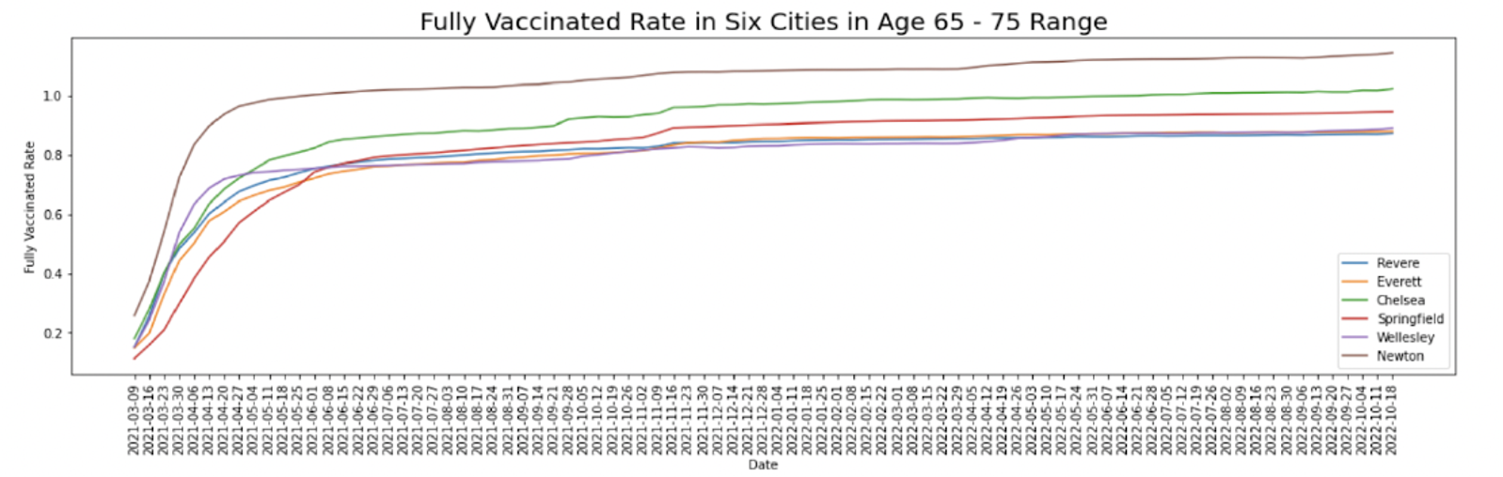
Fully Vaccinated Rate vs. Date
Notes:
People in the 65-75 and 75+ age groups received a large number of vaccinations from March 2021 to April 2021.
Compared to other five cities, Chelsea have higher rates of complete vaccination and growth rates in the 65-75 and 75+ age groups. （high growth rate because green line is more sloping compared to others)

Slide 13
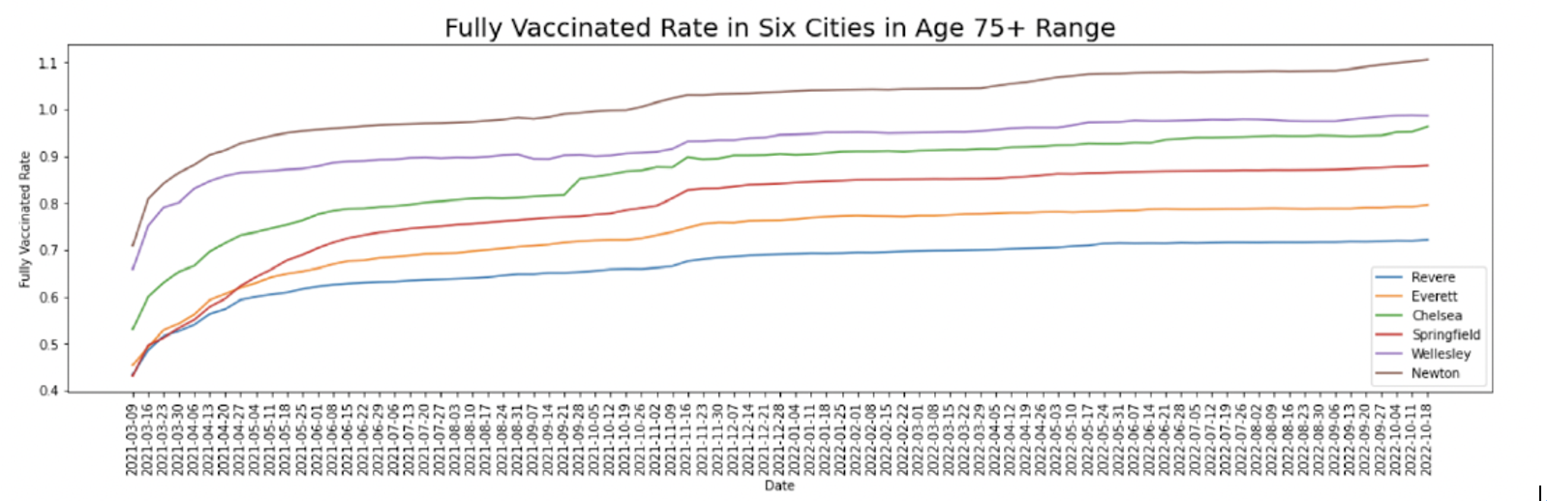
Fully Vaccinated Rate vs. Date

Slide 14
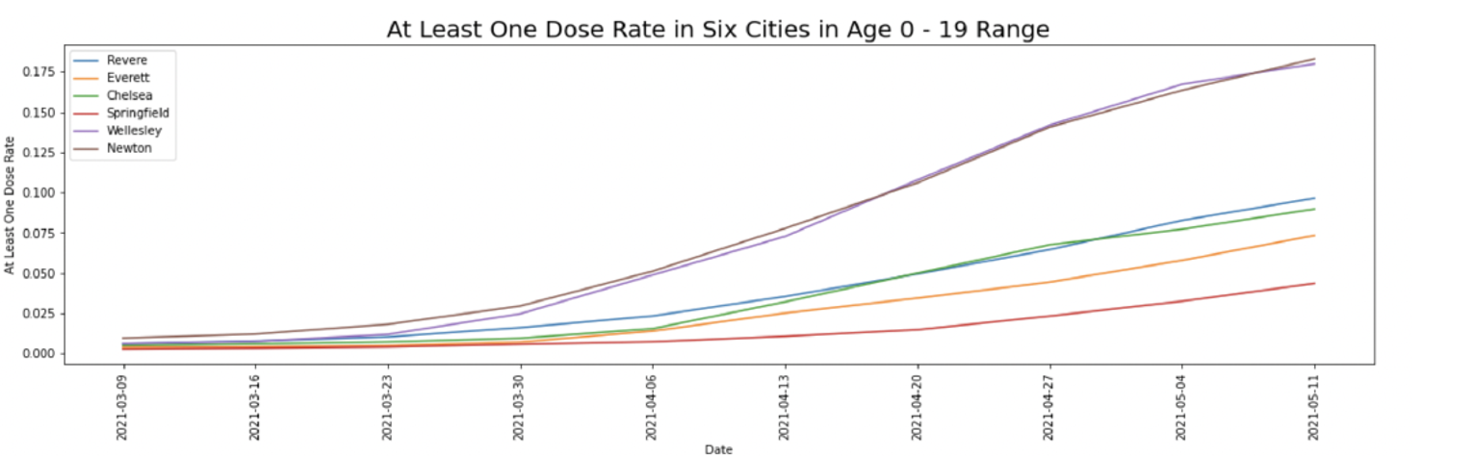
At Least One Dose Rate vs. Date
Notes:
At Least one dose graphs

Slide 15
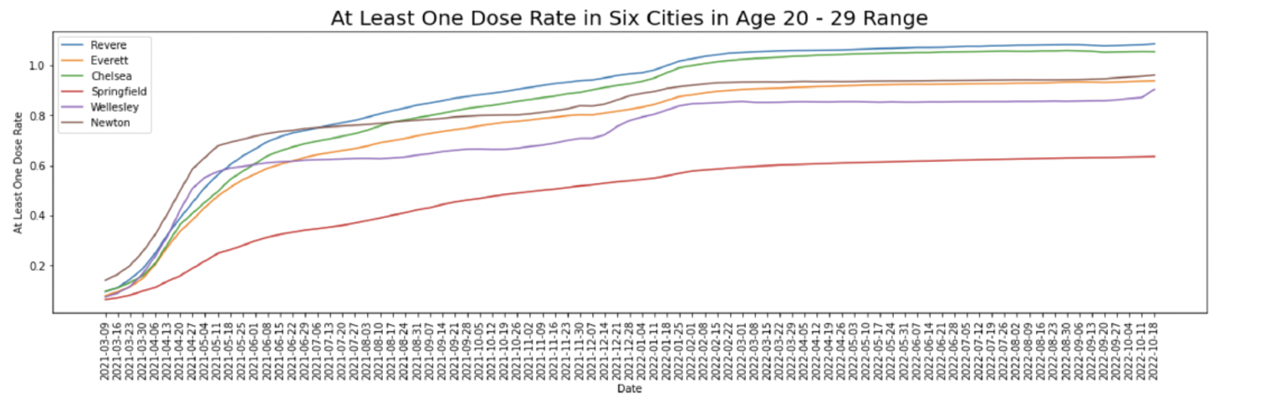
At Least One Dose Rate vs. Date
Notes:
Chelsea had a relatively high vaccination rate in the age group 20-29.

Slide 16
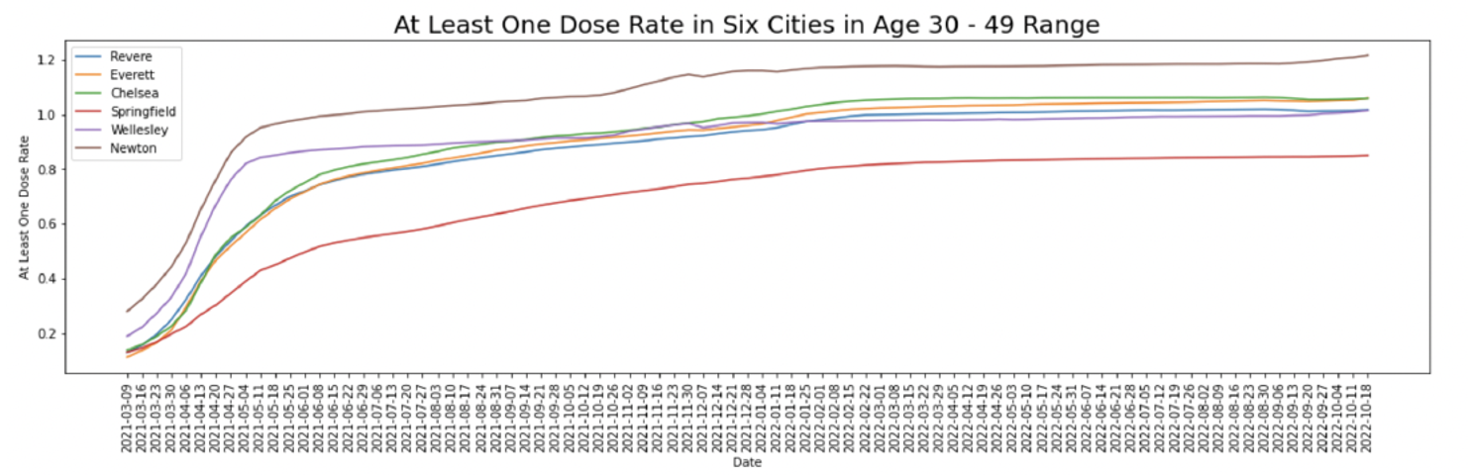
At Least One Dose Rate vs. Date
Notes:
Chelsea had a relatively high vaccination rate in the age group 30-49.

Slide 17
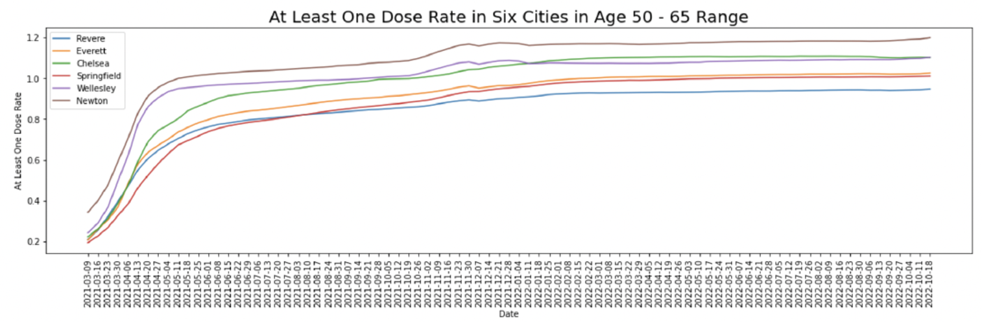
At Least One Dose Rate vs. Date
Notes:
Chelsea had a relatively high vaccination rate

Slide 18
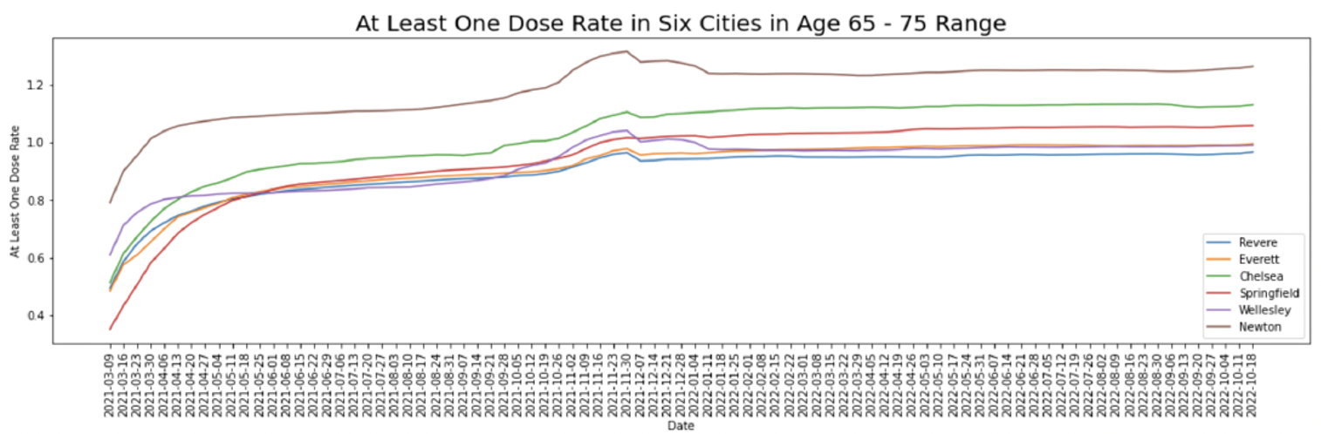
At Least One Dose Rate vs. Date
Notes:
we can see Chelsea also have higher rates of at least one dose in the 65-75 and 75+ age groups.
The rates decreased in 65-75 and 75+ age groups due to the decrease of the population. (elders passed away)

Slide 19
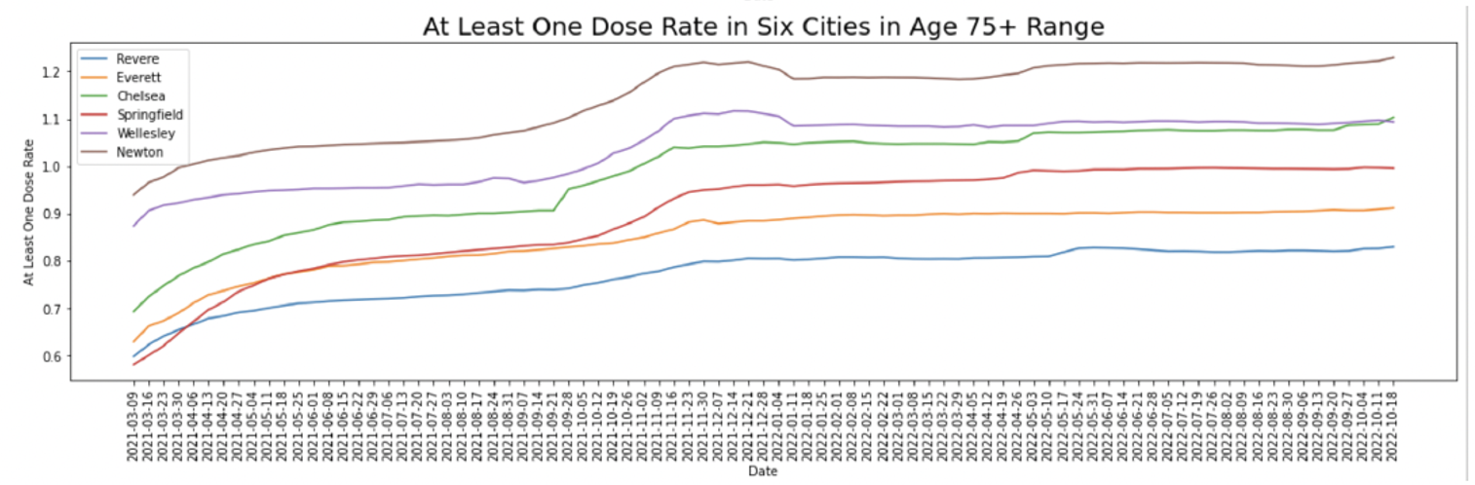
At Least One Dose Rate vs. Date

Slide 20
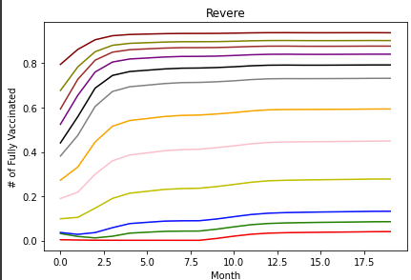
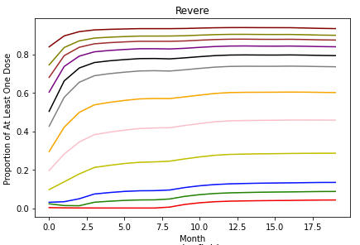
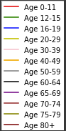
Cumulative Vaccinations: One vs. Fully (Revere)
Proportion Fully Vaccinated

Slide 21
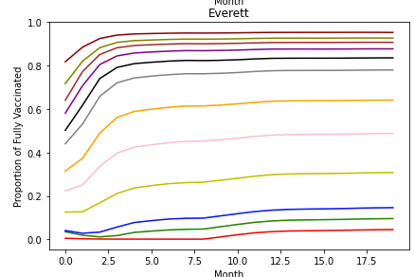
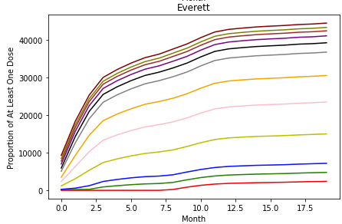
Cumulative Vaccinations: One vs. Fully (Everett)
)

Slide 22
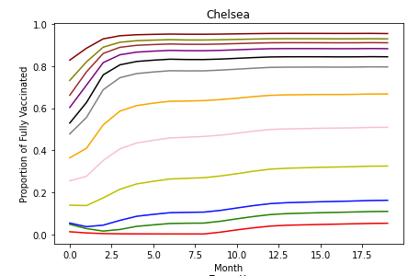
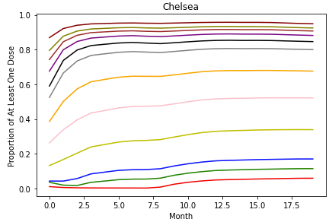
Cumulative Vaccinations: One vs. Fully (Chelsea)

Slide 23
Hypothesis Test
Goal: To investigate whether La Colaborativa has significant influence on pediatric vaccinations.
H0: La Colaborativa doesn’t have great influence on pediatric vaccination in Chelsea. (µc=µ others)
Ha: La Colaborativa has great influence on pediatric vaccination in Chelsea. (µc>µ others)
Result:
The p value shows use that La Colaborativa had significant influence on pediatric vaccinations between Jan 2022 to June 2022 when comparing Chelsea and Newton, and Chelsea and Wellesley for both 5-11 years old and 12-15 years old.
Notes:
After show Ha:
Here I use increase rate (percentage) for comparing the performance of pediatric vaccination for different cities.
Here we can get p values after each t test, and if p<0.05, it is sufficient for us to accept Ha and deny Ha. (High p value means that the higher mean may be caused by accident or some coincidence, so we need to make p=0.05 to make sure that our result is not caused by accident but rigorous test.)
After whole slide:
So it shows that La Colaborativa shows its influence on pediatric vaccination.

Slide 24
Hypothesis Test
Our models suggests that, although La Collaborativa started their operations around March 2021, their operations did not not significantly influence the overall vaccinations in Chelsea
When examining H0 and Ha, for adult doses of one dose or more, only the p-value for individuals 75+ year of age between Chelsea, Newton and Wellesley is less than 0.05, which is insignificant compared to the data from all six age-groups and ten cities.
Result:
This hypothesis result suggests that for at least one dose vaccination, La Collaborativa and its vaccination sites did not show significant impact on overall vaccinations.

Slide 25
Hypothesis Test
For booster, between June 2022 to Oct 2022, La Colaborativa shows significant influence on vaccination on:
16-19, with comparison between Chelsea and Revere, Newton and Wellesley.
20-29, with comparison between Chelsea and Revere, Newton and Wellesley.
30-39, with comparison between Chelsea and Newton, and Wellesley.
40-49, with comparison between Chelsea and Newton, and Wellesley.
50-59, with comparison between Chelsea and Newton, and Wellesley.
60-64, with comparison between Chelsea and Revere, Newton.
65-69, with comparison between Chelsea and Revere, Newton, Everett and Wellesley.
Notes:
With almost the same H0 and Ha for booster, we can find that after the vaccination site starts booster for adults, there are many results’ p-value less than 0.05–which means that we can accept the alternative hypothesis, and La Colaborativa shows significant influence on booster vaccination on so many age ranges and so many cities’ comparison also imply that it has a significant influence on booster vaccination.

Slide 26
Conclusion
Our models strongly suggest that grassroots organizations, like La Collaborativa, had a significant influence on pediatric vaccinations.
There exists lower vaccination rates for younger age groups (ages 0-11) in the beginning of the pandemic and the rates for older age groups dips down during the later stages of the pandemic.
These results correlate with our data given that:
Older individuals tended to be more susceptible to the effects of the virus and thus had an increased mortality rate which contributed to a significant decrease in population
Vaccinations for younger individuals was not made available until later on in the pandemic.
There may have been hesitancy from parents/guardians over the vaccination of their children.

Slide 27
Future Work
Grassroots Organizations: emphasis could be focused on understanding the efforts of grassroots organizations. Getting a better understanding of the impact that these organizations had on the timeline could better help add understanding into how these organizations contributed to the significant shifts in data.
More Data: emphasis could be placed on finding ways to fill in the missing data in our dataset that better reflects the most accurate trends in vaccination rate. Lack of data/no data in many columns suggests that certain features may have more weight than our models predicted.
New Models: Discovering new methods to extract more meaning to our data is always welcome and will better our ability to reach out to underserved populations

